Slide 1
STGV HOME LOAN
Be Owner Of Your Home

Slide 2

HOME PAGE

Slide 3
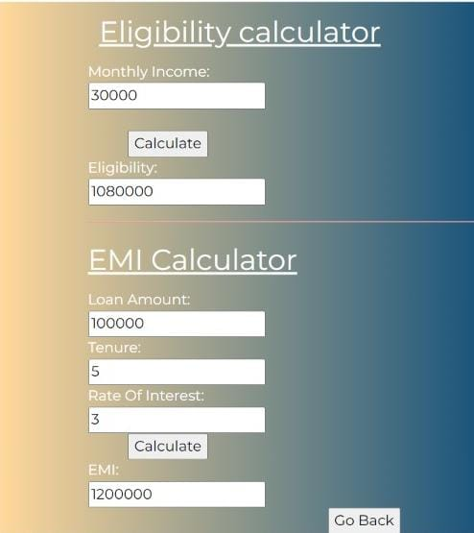
CALCULATORS

Slide 4
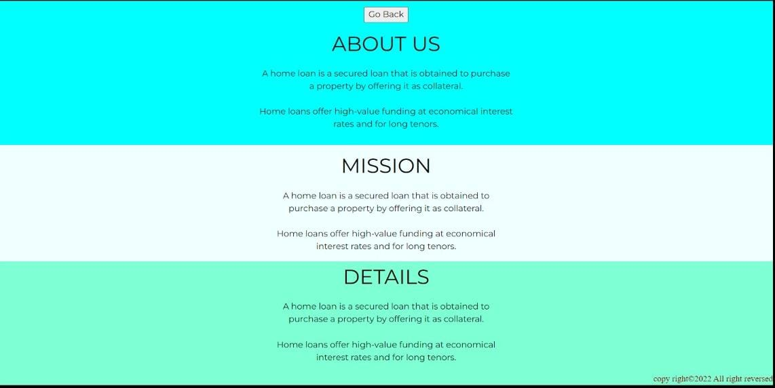
ABOUT US

Slide 5
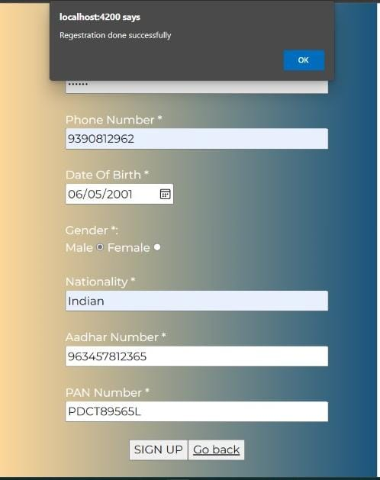
REGISTRATION

Slide 6
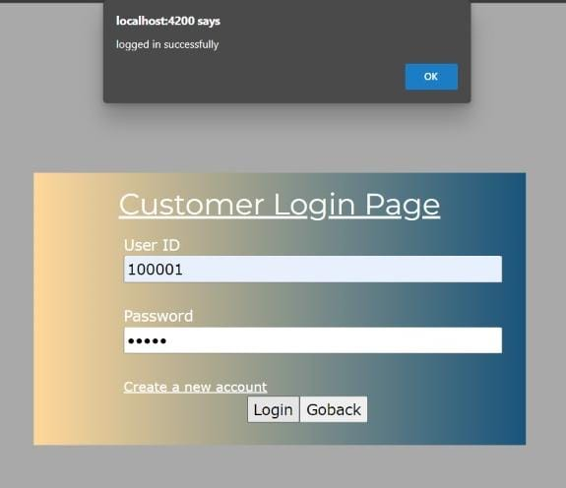
LOGIN PAGE

Slide 7

USER PAGE

Slide 8
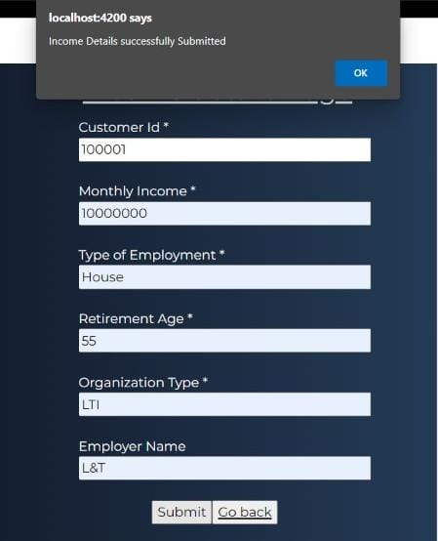
INCOME DETAILS

Slide 9
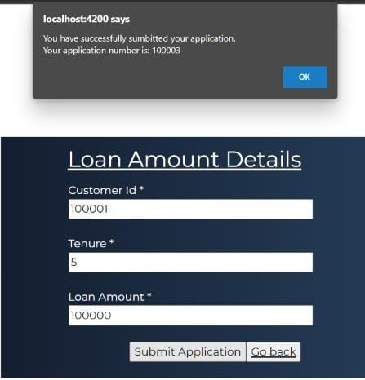
LOAN AMOUNT DETAILS

Slide 10
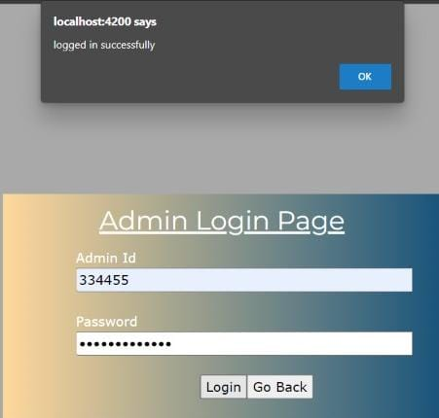
ADMIN LOGIN

Slide 11

ADMIN HOME PAGE

Slide 12
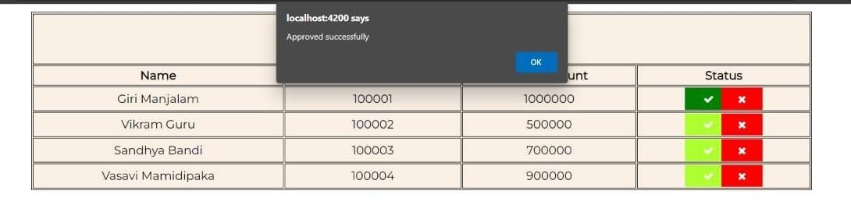
APPLICATION LIST

Slide 13
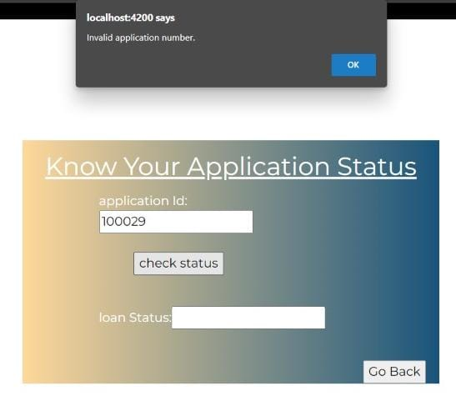
APPLICATION STATUS

Slide 14
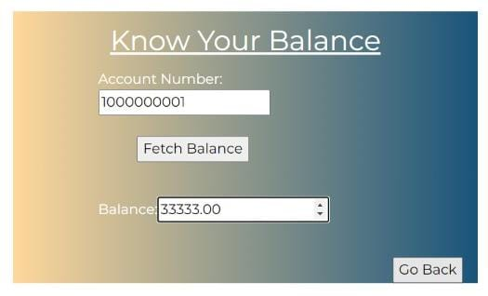
BALANCE AMOUNT

Slide 15
THANK YOU

